Slide 1

The Internet As an Advertising Medium
The Internet’s Evolving IMC Roles
  Building demand
  Conducting transactions
  Filling orders
  Providing customer service
  Serving as an advertising medium
Issues and Concerns
  Increasing flow of advertising revenue to the Internet
  Consumer control of information received
  Versatility and effectiveness of Internet communications in targeting and reaching customers
© 2010 South-Western, a part of Cengage Learning. All rights reserved.
13–<number>

Slide 2
The Two i’s of the Internet:
Individualization and Interactivity
Individualization
  Recognizes that the Internet user has control over the flow of information
Interactivity:
  The capabilities that the Internet gives users to select the information that they perceive as relevant
  The capabilities that the Internet gives brand managers to build relationships with customers via two-way communication
© 2010 South-Western, a part of Cengage Learning. All rights reserved.
13–<number>

Slide 3
The Internet Compared with Other Ad Media
Interactivity as a Disadvantage
  Internet users are highly involved and goal driven (“leaning forward”) when connecting to the Internet, making them more apt to actively avoid unsolicited advertisements as clutter.
  Traditional media users are more casually involved (”leaning back”), making them more receptive to advertisements embedded in the media.
© 2010 South-Western, a part of Cengage Learning. All rights reserved.
13–<number>

Slide 4


Table 13.1
Internet Advertising Formats
Web Sites
Display or Banner Ads
  Rich Media Formats
  Pop-Ups
  Interstitials
  Superstitials
  Video Ads
Blogs, Podcasts, and Social Networks
  Blogs
  Podcasts
  Social Networks
E-mail
  Opt-in Versus Spam
  E-zines
  Wireless E-mail Advertising
  Mobile Phone Advertising
Search Engine Advertising
  Keyword-Matching Advertising
  Content-Targeted Advertising
Advertising via Behavioral Targeting
© 2010 South-Western, a part of Cengage Learning. All rights reserved.
13–<number>

Slide 5
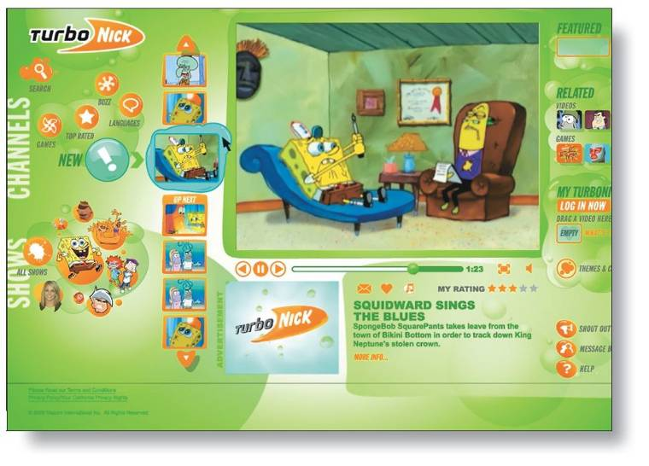
Web Sites
Uses for Web Sites
  As an advertisement for the company
  As a venue for generating and transacting exchanges between organizations and their customers
  As a link to other integrated marcom communications
Well-Designed Web Sites
  Are easy to navigate
  Provide useful information
  Are visually attractive
  Offer entertainment value
  Are perceived as trustworthy
© 2010 South-Western, a part of Cengage Learning. All rights reserved.
13–<number>

Slide 6
Blogs, Podcasts, and Social Networks
Blogs
  Are written by individuals to exchange their views on issues (e.g., products and brands ) with others in online forums
  Are citizen journalism—online word-of-mouth
  Are an interactive medium that businesses can use to connect with customers and appear more credible.
Podcasts
  Are self-produced radio-style online programs to which consumers can subscribe
  Enable advertisers to target consumers who have self-selected programs of interest to them
© 2010 South-Western, a part of Cengage Learning. All rights reserved.
13–<number>

Slide 7
Blogs, Podcasts, and Social Networks
Social Networks
  Allow users to interact with “friends,” share opinions and information, and create online communities
  Developed by businesses enable consumers to learn from one another and to share their experiences
    P&G’s “The People’s Choice”
    Mattel’s Barbiegirls.com
  Are presently unproven marcom tool
© 2010 South-Western, a part of Cengage Learning. All rights reserved.
13–<number>

Slide 8
E-mail Advertising
E-mail as a Effective Marcom Tool
  + Delivering advertising messages
  + Providing sales incentives to mass audiences or targeted groups
  – Sending junk mail (spamming) and phishing
Opt-In E-mailing
  Is the process of marketers asking for permission to send messages to consumers
  Avoids the flow of irrelevant inbound messages
  Allows marketers to provide targeted information that is of interest to the receiver
© 2010 South-Western, a part of Cengage Learning. All rights reserved.
13–<number>

Slide 9
E-mail Advertising (cont’d)
E-mail magazines (E-zines)
  Are free magazine-like publications that deliver specialized content and credible advertising messages to targeted audiences
Wireless E-mail Advertising (WiFi)
  Allows users to connect to the Internet through WiFi hotspots
  Offers significant marcom potential in its ability to message consumers with pertinent offers from stores close to their location.
© 2010 South-Western, a part of Cengage Learning. All rights reserved.
13–<number>

Slide 10
The Special Case of Mobile Phones
Cellular Phones as the Third Screen
  Mobility and universal coverage
    WiFi technology for Internet Access
    Short Messaging System (SMS) for text messaging
    Multimedia Messaging Service for graphics and sounds
  Music, game, video, and ringtone downloads
Marcom Issues
  Invasion of privacy—negative consumer responses to unsolicited messages
  Limited advertising space on cell screens
  Gaining consumer acceptance of opt-in advertising
© 2010 South-Western, a part of Cengage Learning. All rights reserved.
13–<number>

Slide 11
Search Engine Advertising (SEA)
Search Engine Advertising (SEA)
  Is fastest growing form of Internet advertising—about 40% of online advertising spending
  Includes a variety of well-known services (e.g.; Google, MSN Search, and Yahoo!) that people use when seeking information
  Attempts to place messages in front of people when their natural search efforts indicate they are interested in buying a particular good or service
  Makes use of paid keywords to increase the odds that a firm’s product or service will be included in the search results and appear as a sponsored link
© 2010 South-Western, a part of Cengage Learning. All rights reserved.
13–<number>

